Slide 1
FOOD INVENTORY
Student name

Slide 2
contents
Introduction
Literature Survey
Motivation
Existing System
Proposed Work
System Architecture
Data Flow Diagram
Mathematical Model
Implementation
Test Cases
Result Analysis
Conclusion and Future Scope
References
Publication

Slide 3
Abstract
The amount of food waste generated in the country continually increasing, the misuse of food along each stage of the food lifecycle has become a serious environmental, social, and financial issue. Huge quantity of food is wasted every day in hotels and restaurants. The waste at marriage halls, a party hall etc. is also gigantic. In a country, a huge society is deprived of basic amenities and don't get meal for one time, such wastage is intolerable. It is an irony that there are hundreds of orphanage working towards helping the people belonging to under-privileged society and want to at least provide them with bare minimum requirements such as food and shelter. The proposed method says that if we can connect these two, in such a way that these orphanage can get the "food to be wasted" without hassle.

Slide 4
Introduction
In the country where the commercial status has reached in a stage that tons of available edible food is heaved away as waste in every stage of the marketing. Food wastage is estimated 25% of the available amount of succulent food. The food is important energy demanding product group and resource. The prevention of food waste can be done by contributing to save resources to reduce environmental impact during all stages of marketing system. Nobody intends to waste food in the beginning, some situation in marketing behavior and individual lead to the food waste. People waste edible food as an accomplishment suggestive of our population. Food throwing is a disquieting issue everywhere. The street and trash bins depot have more food as a clue to prove it. The functions and party halls of hotels eject out so much food.

Slide 5
Literature Survey
Sr. No. | Paper name |  | Author | Description
1 | Parallel Control and Management for Intelligent Transportation Systems |  | : Fei-Yue Wang, Fellow, IEEE. | Parallel control and management have been proposed as a new mechanism for conducting operations of complex systems, especially those that involved complexity issues of both engineering and social dimensions, such as transportation systems.
2 | Intelligent freight-transportation systems: |  | : Teodor Gabriel Crainic | . —. While it is certainly too early to make a definitive assessment of the effectiveness of IntelligentTransportation Systems (ITS), it is not to take stock of what has been achieved and tothink about what could be achieved in the near future
3 | : Intelligent logistics: Involving the customer |  | Duncan McFarlane | — The role of logistics in effective supply chain management is increasingly critical, and researchers and practitioners have recently focused their attention in designing more intelligent systems to address today’s challenges
4 | . Data-Driven Intelligent Transportation Systems: A Survey |  | : Junping Zhang | : For the last two decades, intelligent transportation systems (ITS) have emerged as an efficient way of improving the performance of transportation systems, enhancing travel security, and providing more choices to travelers

Slide 6
Existing System
There is missing of food wastage management system. Hotel, restaurant, party hall, marriage hall distribute extra food with their employees and remaining food is throwaway

Slide 7
Disadvantageous of existing system
1.Unreliable system
2.Food wastage generate serious environmental, social, and financial issue
.

Slide 8
Problem Statement
The amount of food waste generated in the country continually increasing. To solve this problem we need effective system.
.

Slide 9
Proposed System
In propose system all orphanage, NGOs will be register on government website with respected to their locations. Registration will also contain basic information of all members, by which it will easy to recognize daily need of food quantity. Similar all hotels, caters, event organizers also get register on website. Each hotel, caters will provide their daily fix quantity of food to nearby NGOs and Orphanage to avoid food wastage

Slide 10
Advantageous of Proposed System
1.Use of technology reduce efforts
2.Utilization of extra food to nourishments needy people

Slide 11
motivation
The succulent food which is wasted could be reorganizing for human utilization. Throwing available and edible waste food can be simply nourished by someone else and is sheer wastes of resources. orphanage works as food collectors, collects food and redistribute dry food and cooked food from donor to community centers (needy people). The approach deals with collecting the food waste by orphanage and donating to needy people (charity homes), considering the types and sources of food. The approach support orphanage to collect surplus food waste from donor and donate that food to needy people.

Slide 12
Objectives
We make use of a widely used data mining tool called . We apply KNN and hour sign algorithm to the academic records of a group of ngo and obtain the best association rules which will help in food distribution
.

Slide 13
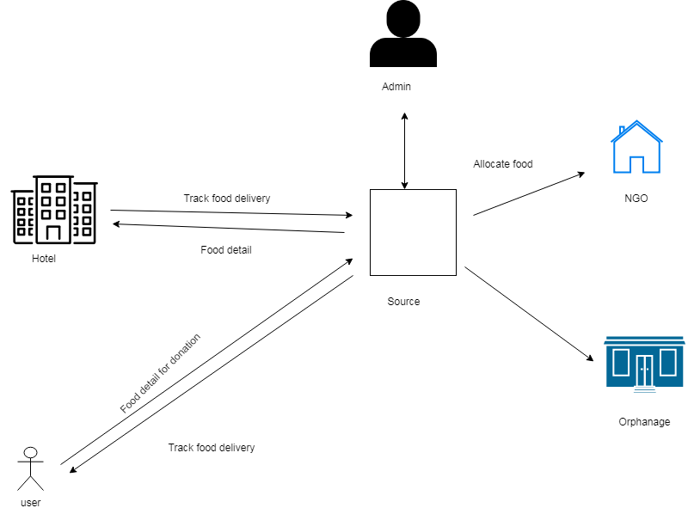
Proposed System Architecture

Slide 14
System Specification
HARDWARE REQUIREMENTS:
System : Pentium IV 2.4 GHz.
Hard Disk : 40 GB.
Monitor : 15 VGA Colour.
Mouse : Logitech.
Ram : 512 Mb.
SOFTWARE REQUIREMENTS:
Operating system : Windows XP/7.
Coding Language : JAVA
IDE : Eclipse
Database : MYSQL

Slide 15
Mathematical modUlE
Let S is the Whole System Consist of
S= {I, P, O}
I = Input.
I = {U, Q, A, S, D}
U = User
U = {u1,u2….un}
Q = Query Entered by user
Q = {q1, q2, q3…qn}
D = Dataset
P = Process:
Step1: User will enter the query.
Step2: After entering query the following operations will be performed.

Slide 16
Step3: Data mining can be applied to educational databases to identify undesirable student behavior which was previously unknown. We can construct coursework, plan and schedule classes, model students, predict their performance and provide recommendations for students, using data mining technique.

Slide 17
module
Admin
NGO
Hotel
Orphonage

Slide 18
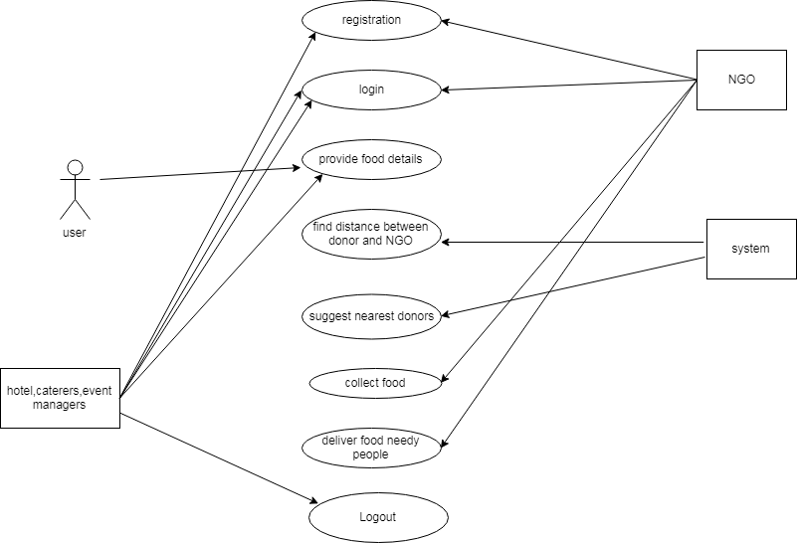
USE CASE DAIGRAM

Slide 19
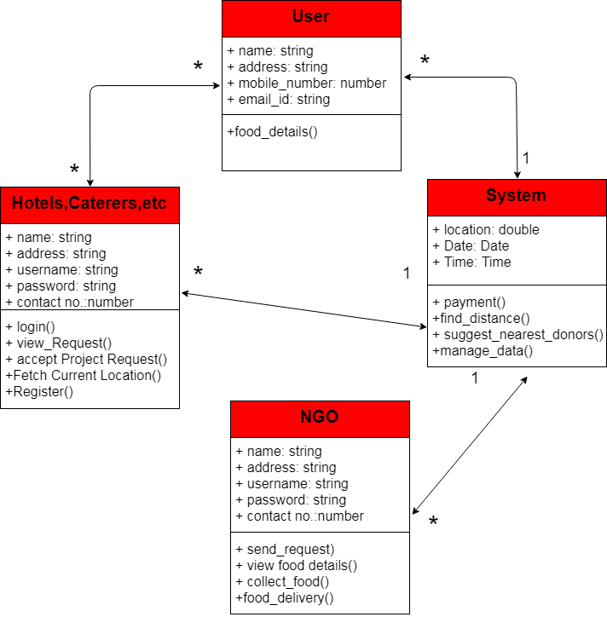
Class diagram

Slide 20
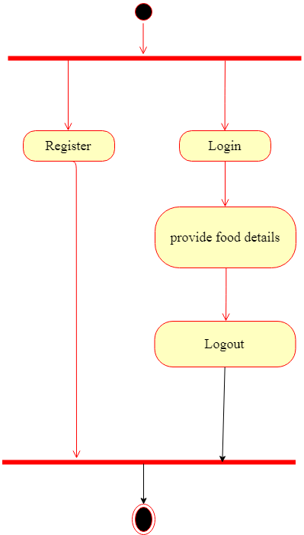
Activity diagram

Slide 21
SEQUENCE DIAGRAM

Slide 22
APPLICATIONS
1.hotel,user,NGO can register in application.
2.Find nearest NGO.

Slide 23
Conclusion
The sustenance approach serves to stay away from crevice between the Ngo and Donor. The approach serves to give the sustenance waste to the penniless individuals who are battling for nourishment. The approach unite these two, in such a route, to the point that these NGOs can persuade the "nourishment to be squandered" without bother, and the inns/eateries/party-lobbies discover these sustenance seekers with no additional exertion then it will serve a more noteworthy cause and will be an enormous administration to mankind.

Slide 24
Referances
[1] F.-Y. Wang, “Parallel control and management for intelligent transportation
systems: Concepts, architectures, and applications,” IEEE Trans.
Intell. Transp. Syst., vol. 11, no. 3, pp. 630–638, Sep. 2010.
[2] T. G. Crainic, M. Gendreau, and J.-Y. Potvin, “Intelligent freighttransportation
systems: Assessment and the contribution of operations
research,” Transp. Res. C, Emerg. Technol., vol. 17, no. 6, pp. 541–557,
2009.
[3] D. McFarlane, V. Giannikas, and W. Lu, “Intelligent logistics: Involving
the customer,” Comput. Ind., vol. 81, pp. 105–115, Sep. 2016.
[4] J. Zhang, F.-Y. Wang, K. Wang, W.-H. Lin, X. Xu, and C. Chen, “Datadriven
intelligent transportation systems: A survey,” IEEE Trans. Intell.
Transp. Syst., vol. 12, no. 4, pp. 1624–1639, Dec. 2011.
[5] A. M. Campbell and M. W. P. Savelsbergh, “A decomposition approach
for the inventory-routing problem,” Transp. Sci., vol. 38, no. 4,
pp. 488–502, 2004.

